Slide 1
Machine Learning
Dr. Raman Singh
Assistant Professor, CSED
Raman.singh@thapar.edu

Slide 2
Course Introduction
Subject: Machine Learning
Course Code: UML501
Credit: 4.0
Evaluation Criteria:
Quizzes and Lab Evaluation
Mid Semester Test (MST)/ End Semester Test (EST)

Slide 3
Books
Text Books:
1. Machine Learning, Tom Mitchell, McGraw Hill, 1997, 1st Edition.
2. Introduction to Machine Learning, by Alpaydin Ethem, 2014, 3rd Edition.

Slide 4
Why “Learn” ?
Machine learning is programming computers to optimize a performance criterion using example data or past experience.
There is no need to “learn” to calculate payroll
Learning is used when:
Human expertise does not exist (navigating on Mars),
Humans are unable to explain their expertise (speech recognition)
Solution changes in time (routing on a computer network)
Solution needs to be adapted to particular cases (user biometrics)

Slide 5
What We Talk About When We Talk About“Learning”
Learning general models from a data of particular examples
Data is cheap and abundant (data warehouses, data marts); knowledge is expensive and scarce.
Example in retail: Customer transactions to consumer behavior:
People who bought “Blink” also bought “Outliers” (www.amazon.com)
Build a model that is a good and useful approximation to the data.

Slide 6
Data Mining
Retail: Market basket analysis, Customer relationship management (CRM)
Finance: Credit scoring, fraud detection
Manufacturing: Control, robotics, troubleshooting
Medicine: Medical diagnosis
Telecommunications: Spam filters, intrusion detection
Bioinformatics: Motifs, alignment
Web mining: Search engines
...

Slide 7
What is Machine Learning?
Optimize a performance criterion using example data or past experience.
Role of Statistics: Inference from a sample
Role of Computer science: Efficient algorithms to
Solve the optimization problem
Representing and evaluating the model for inference

Slide 8
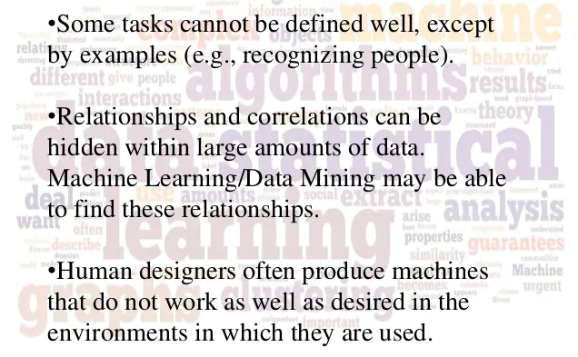
Why Machine Learning?

Slide 9
What is the Learning Problem?
Learning = Improving with experience at some task
Improve over task T ,
with respect to performance measure P ,
based on experience E.
E.g., Learn to play checkers
T : Play checkers
P : % of games won in world tournament
E: opportunity to play against self

Slide 10
Learning to Play Checkers
T : Play checkers
P : Percent of games won in world tournament
What experience?
What exactly should be learned?
How shall it be represented?
What specific algorithm to learn it?

Slide 11
Some Issues in Machine Learning
What algorithms can approximate functions well (and when)?
How does number of training examples impact accuracy?
How does complexity of hypothesis representation impact it?
How does noisy data in impact accuracy?
What are the theoretical limits of learnability?
How can prior knowledge of learner help?
What clues can we get from biological learning systems?
How can systems alter their own representations?

Slide 12
Applications
Association
Supervised Learning
Classification
Regression
Unsupervised Learning
Reinforcement Learning

Slide 13
Learning Associations
Basket analysis:
P (Y | X ) probability that somebody who buys X also buys Y where X and Y are products/services.
Example: P ( chips | beer ) = 0.7

Slide 14
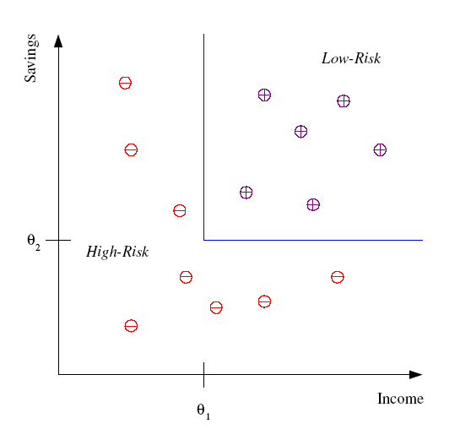
Classification
Example: Credit scoring
Differentiating between low-risk and high-risk customers from their income and savings
Discriminant: IF income > θ₁ AND savings > θ₂
THEN low-risk ELSE high-risk

Slide 15
Classification: Applications
Aka Pattern recognition
Face recognition: Pose, lighting, occlusion (glasses, beard), make-up, hair style
Character recognition: Different handwriting styles.
Speech recognition: Temporal dependency.
Medical diagnosis: From symptoms to illnesses
Biometrics: Recognition/authentication using physical and/or behavioral characteristics: Face, iris, signature, etc
...

Slide 16








Face Recognition
Training examples of a person
Test images
ORL dataset,
AT&T Laboratories, Cambridge UK

Slide 17
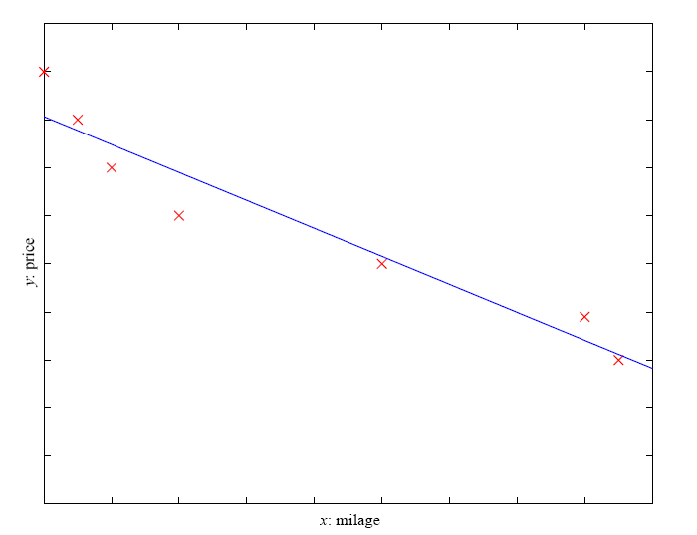
Regression
Example: Price of a used car
x : car attributes
y : price
y = g (x | θ )
g ( ) model,
θ parameters
y = wx+w₀

Slide 18
Regression Applications
Navigating a car: Angle of the steering
Kinematics of a robot arm
(x,y)
α₁= g₁(x,y)
α₂= g₂(x,y)
α₂
α₁
Response surface design

Slide 19
Supervised Learning: Uses
Prediction of future cases: Use the rule to predict the output for future inputs
Knowledge extraction: The rule is easy to understand
Compression: The rule is simpler than the data it explains
Outlier detection: Exceptions that are not covered by the rule, e.g., fraud

Slide 20
Unsupervised Learning
Learning “what normally happens”
No output
Clustering: Grouping similar instances
Example applications
Customer segmentation in CRM
Image compression: Color quantization
Bioinformatics: Learning motifs

Slide 21
Reinforcement Learning
Learning a policy: A sequence of outputs
No supervised output but delayed reward
Credit assignment problem
Game playing
Robot in a maze
Multiple agents, partial observability, ...

Slide 22
Resources: Datasets
UCI Repository: http://www.ics.uci.edu/~mlearn/MLRepository.html
UCI KDD Archive: http://kdd.ics.uci.edu/summary.data.application.html
Statlib: http://lib.stat.cmu.edu/
Delve: http://www.cs.utoronto.ca/~delve/

Slide 23
Resources: Journals
Journal of Machine Learning Research www.jmlr.org
Machine Learning
Neural Computation
Neural Networks
IEEE Transactions on Neural Networks
IEEE Transactions on Pattern Analysis and Machine Intelligence
Annals of Statistics
Journal of the American Statistical Association
...

Slide 24
Resources: Conferences
International Conference on Machine Learning (ICML)
European Conference on Machine Learning (ECML)
Neural Information Processing Systems (NIPS)
Uncertainty in Artificial Intelligence (UAI)
Computational Learning Theory (COLT)
International Conference on Artificial Neural Networks (ICANN)
International Conference on AI & Statistics (AISTATS)
International Conference on Pattern Recognition (ICPR)
...

